Slide 1
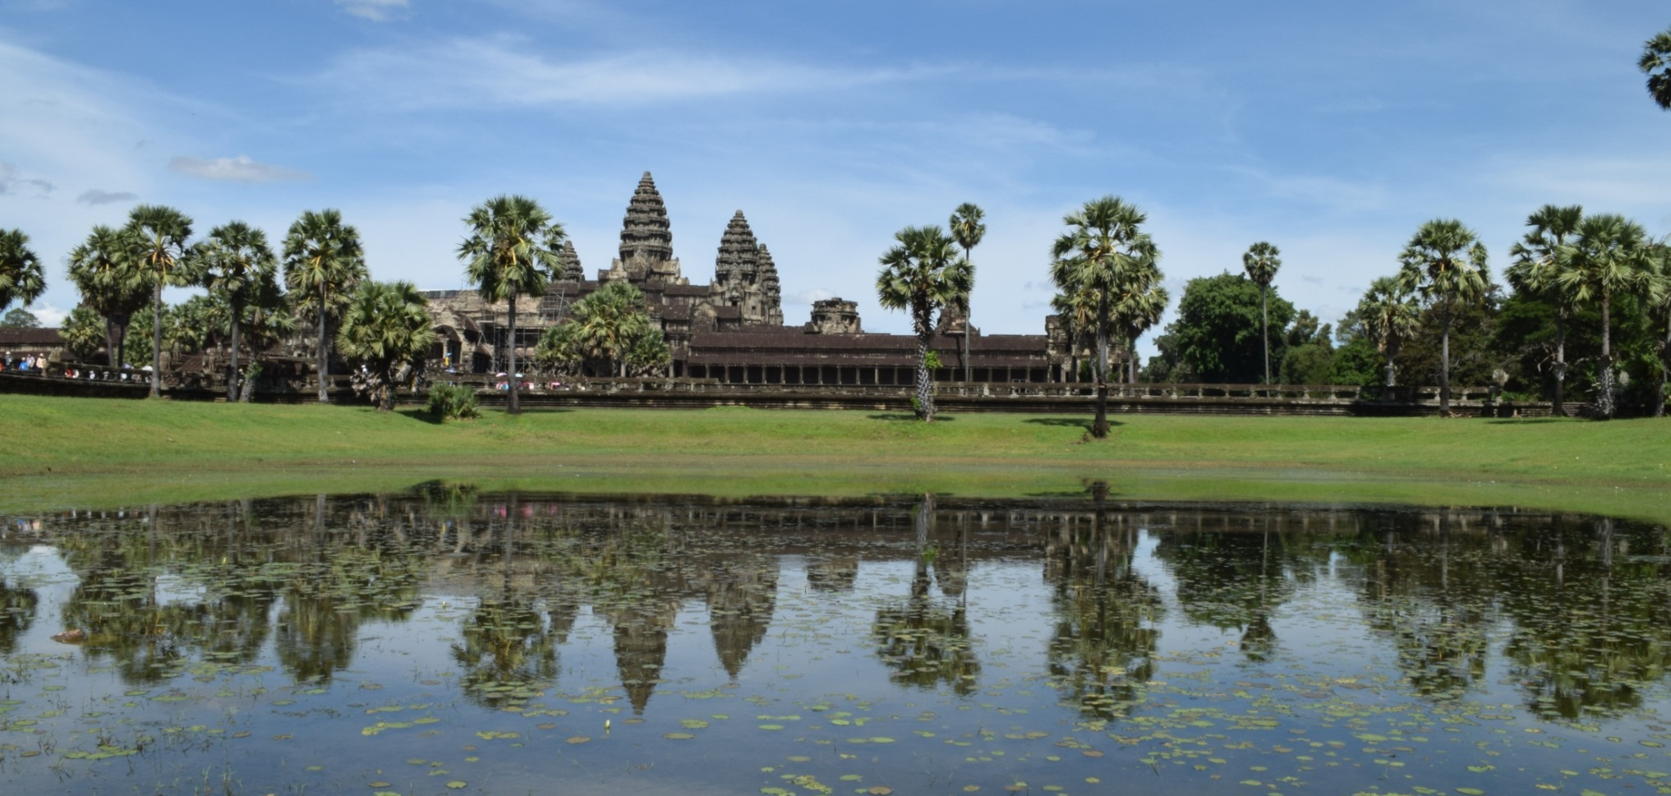
AFID Volunteering Carl Chaplin
The Cambodian Rural Development Team, Kratie, Cambodia
15th June – 25th September 2015

Slide 2
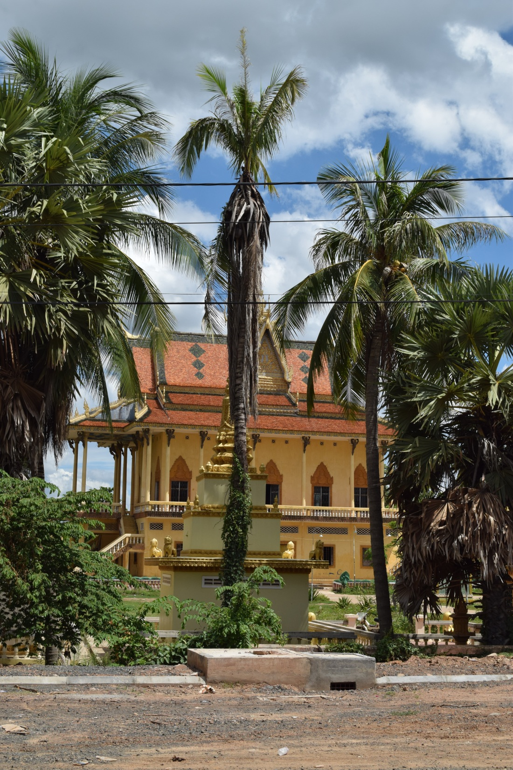
Contents
Why?
Skills required
My work at CRDT
A typical day
Adventures had along the way
Advice to future volunteers

Slide 3
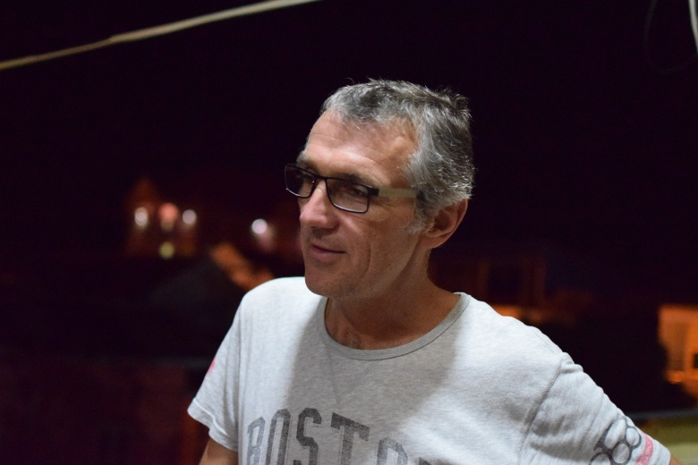
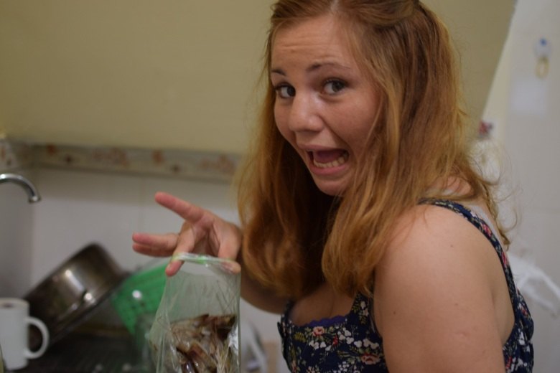
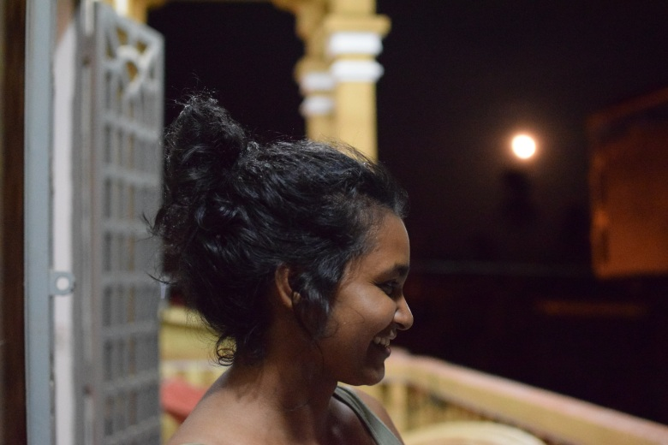
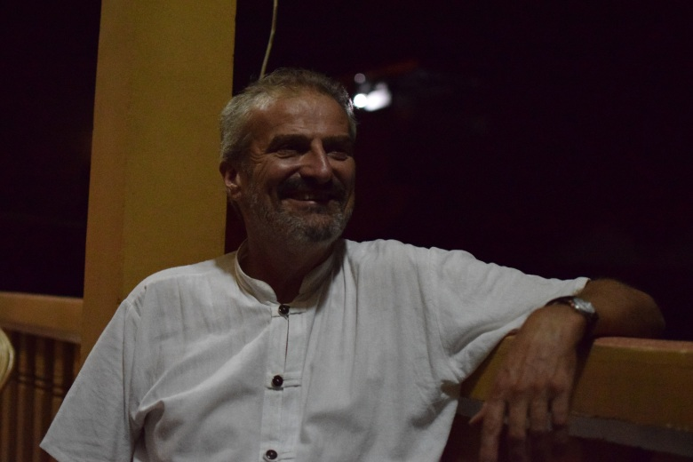
Why Did I Volunteer?
To travel with a purpose
To immerse myself in another culture
To take my skills where they are in short supply
Meet some interesting people

Slide 4
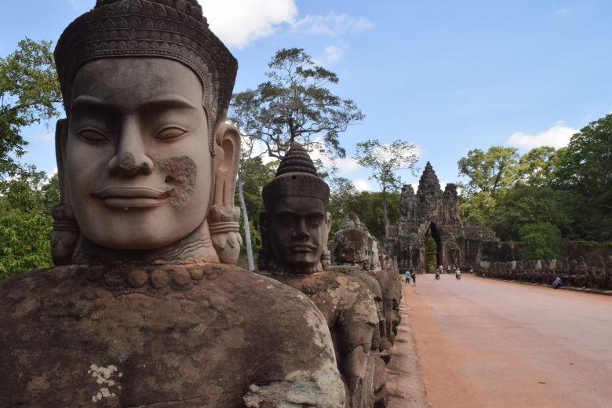
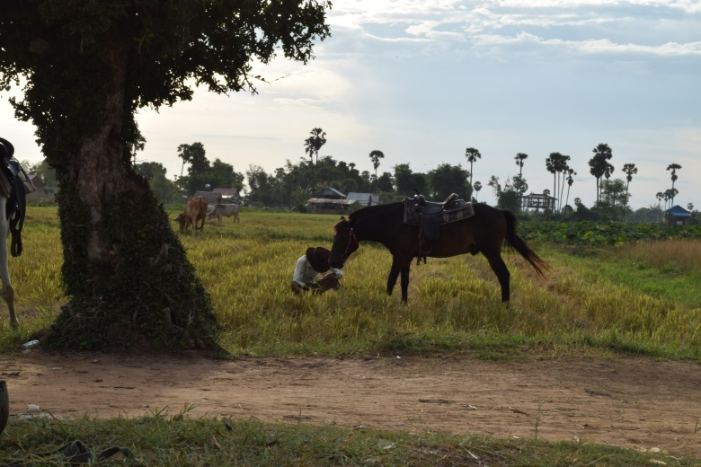
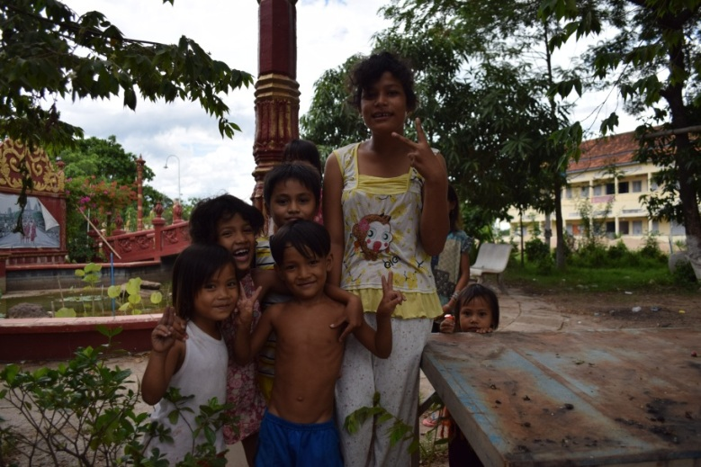
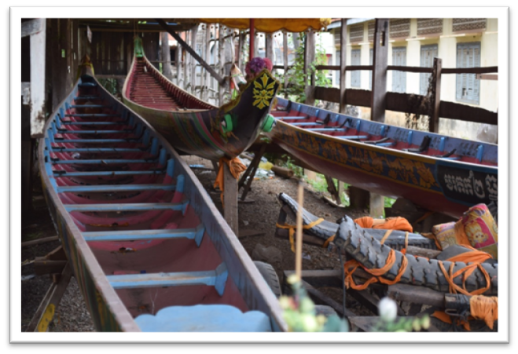
Why Cambodia?
It’s beautiful
It’s safe
The Khmer people
The History
It is likely to change a great deal in the coming years.

Slide 5
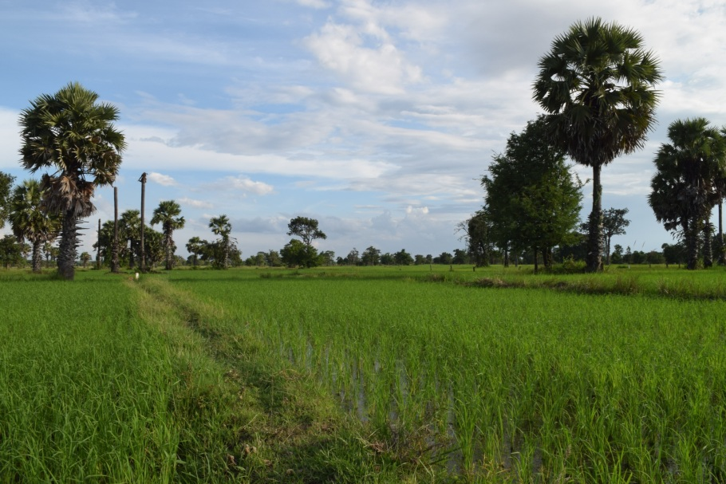
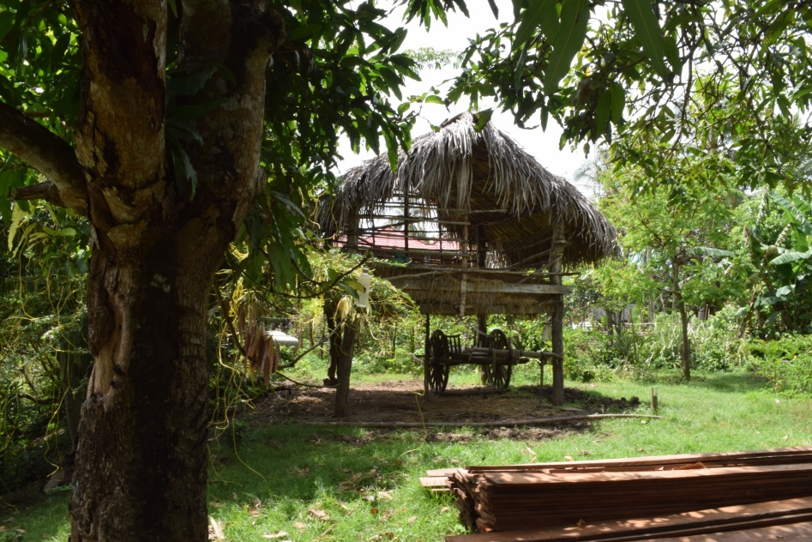
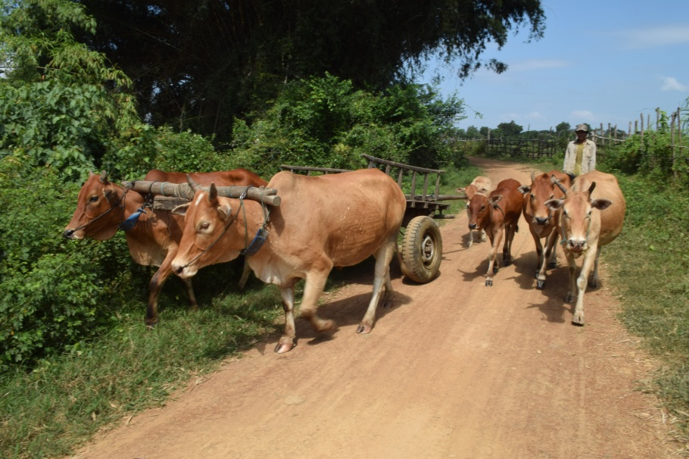
Why Rural Cambodia?
It’s more beautiful
It’s safer
The adventure of living somewhere remote
The added need for accountants in Rural areas

Slide 6
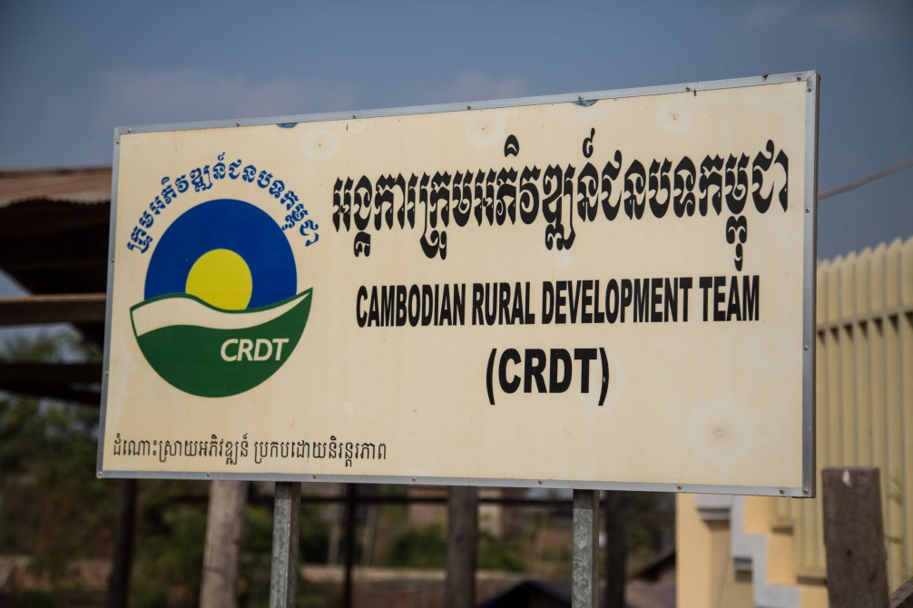
Why CRDT?
They are an effective NGO
They understand the local issues
They have a good team
They understand the need to build capacity in their staff
They have a supportive management team
They welcome change
They are ambitious as an organisation
They have a good track record
They are looking to continue to grow

Slide 7
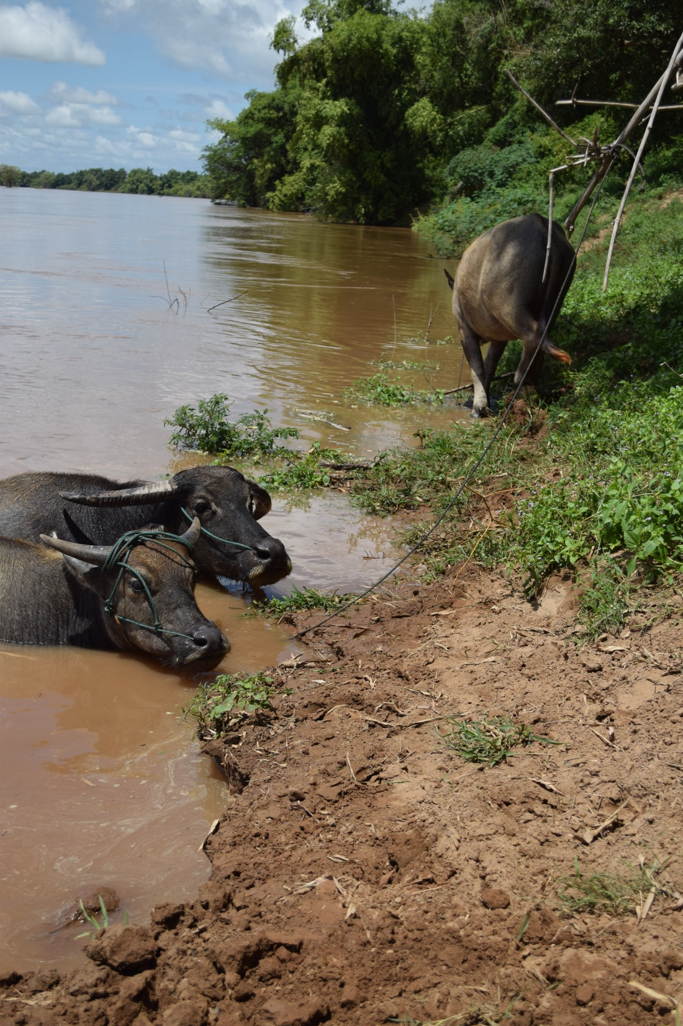
Experience and Skills Required
Working with people
building confidence and capacity within the finance team
establishing trust between you and the finance team
Building communication between the finance team and other departments
Accounting Skills
Understanding existing processes
Identifying errors and inefficiencies
Process engineering/re-engineering
Internal and external reporting

Slide 8
My work at CRDT
Developing a 5 year financial model for MCA
2015 Budget
Donor Agreement Spread sheet
Audit preparation
Accounting process re-engineering
Recruitment
Staff Training

Slide 9
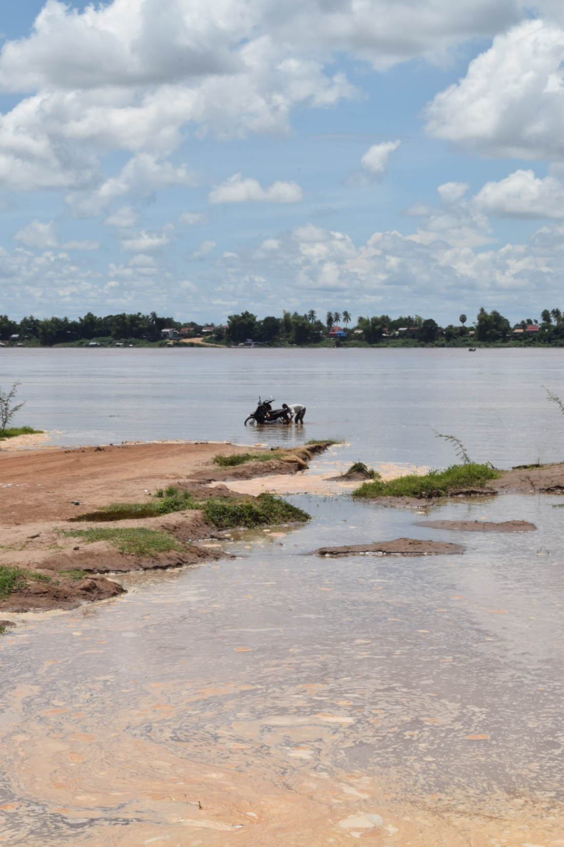
A Typical Day In The Office
8:30 – 12:00; 14:00 – 17:30
Preparing for meetings
Board Meetings
Staff Quarterly Meeting
Preparing analysis for management
Preparing reports for donors
Dealing with ad hoc issues
Donors
Internal issues

Slide 10
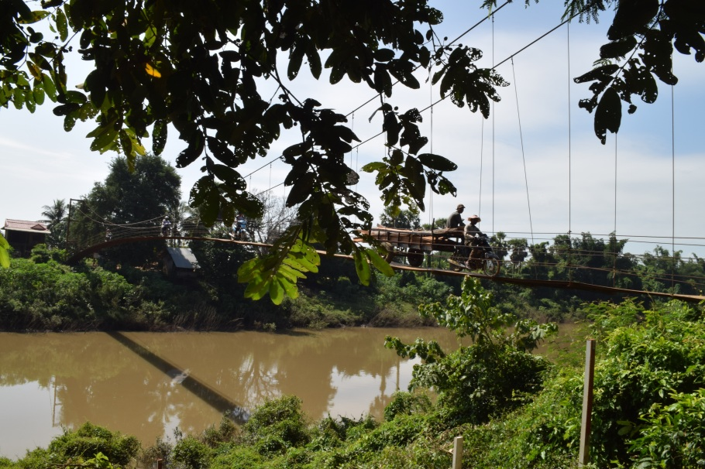
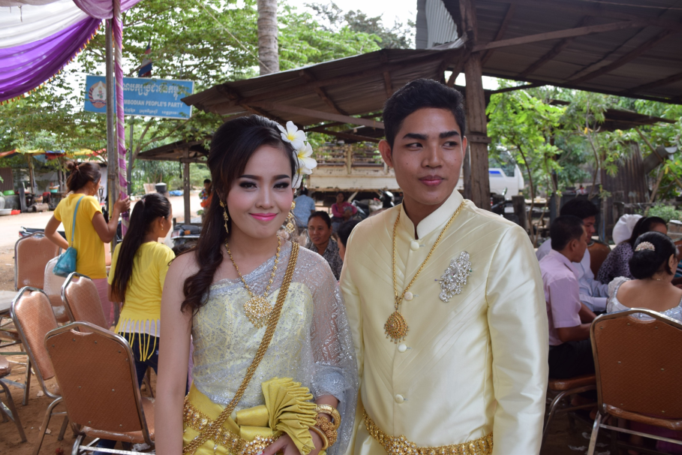
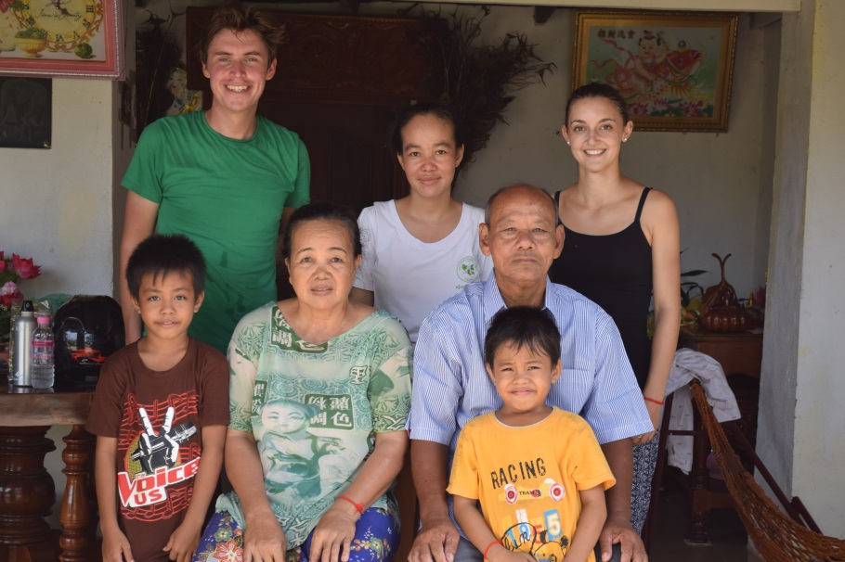
A Typical Day After hours in Kratie
Friday night volunteer social
Sunday morning motorbike rides
Thida’s engagement party
Visit to Saray’s family home

Slide 11
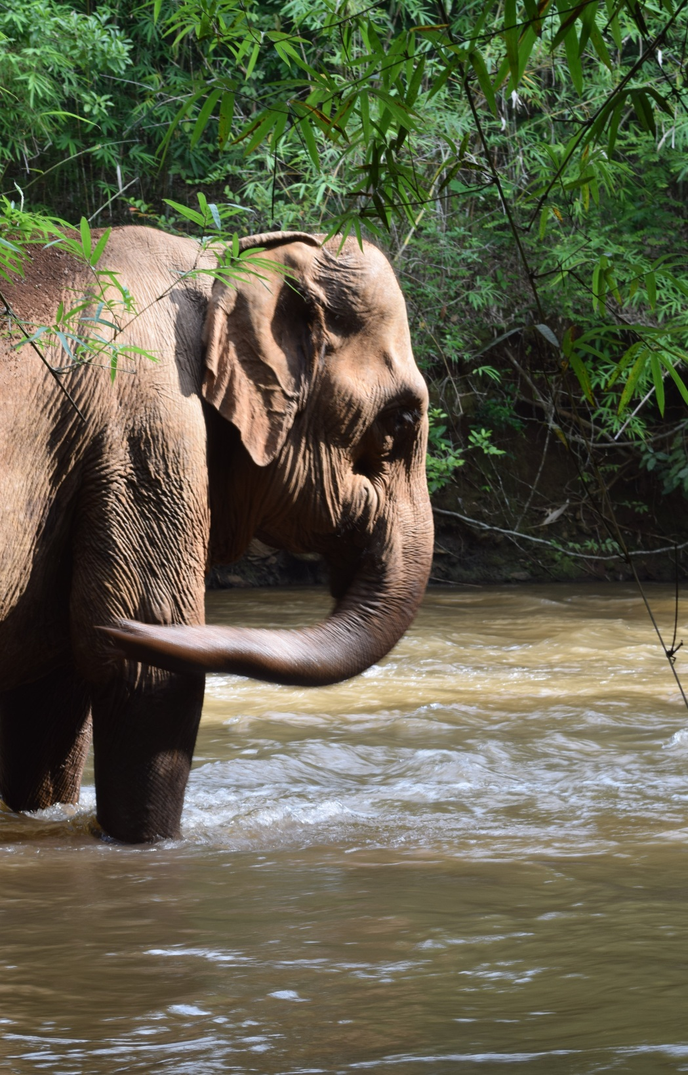
Adventures had along the Way
Exploring by Kayaking
Exploring Kratie Province by Motorbike
Mondulkiri
Ho Chi Minh
Siem Reap

Slide 12
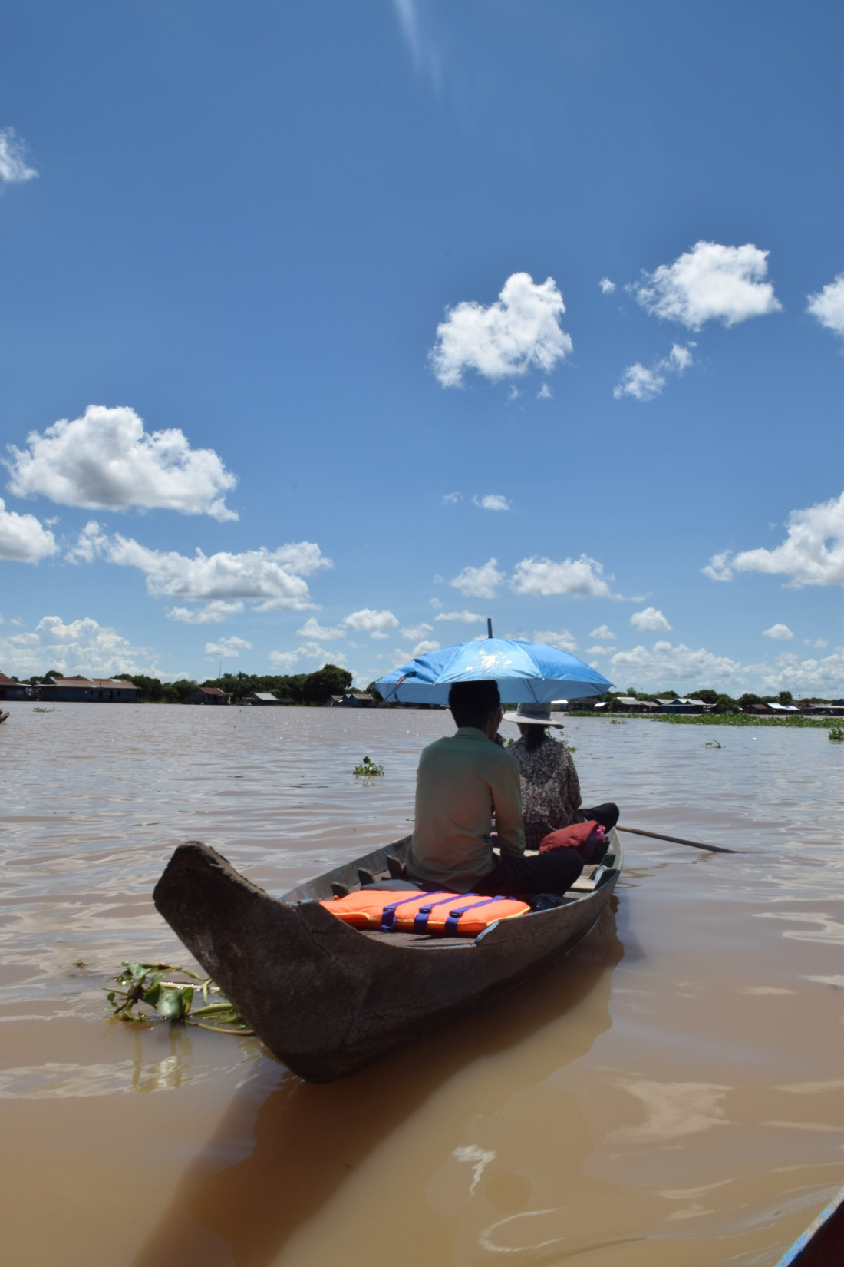
Advice to future volunteers
Understand the local customs before you react to situations
Think about renting an apartment, even for short placements
Find out about getting around, bike rental, motto rental, local busses etc.
Find out about your nearest health facilities
Get all the recommended vaccines
Beware of the dogs (and cats)!

Slide 13
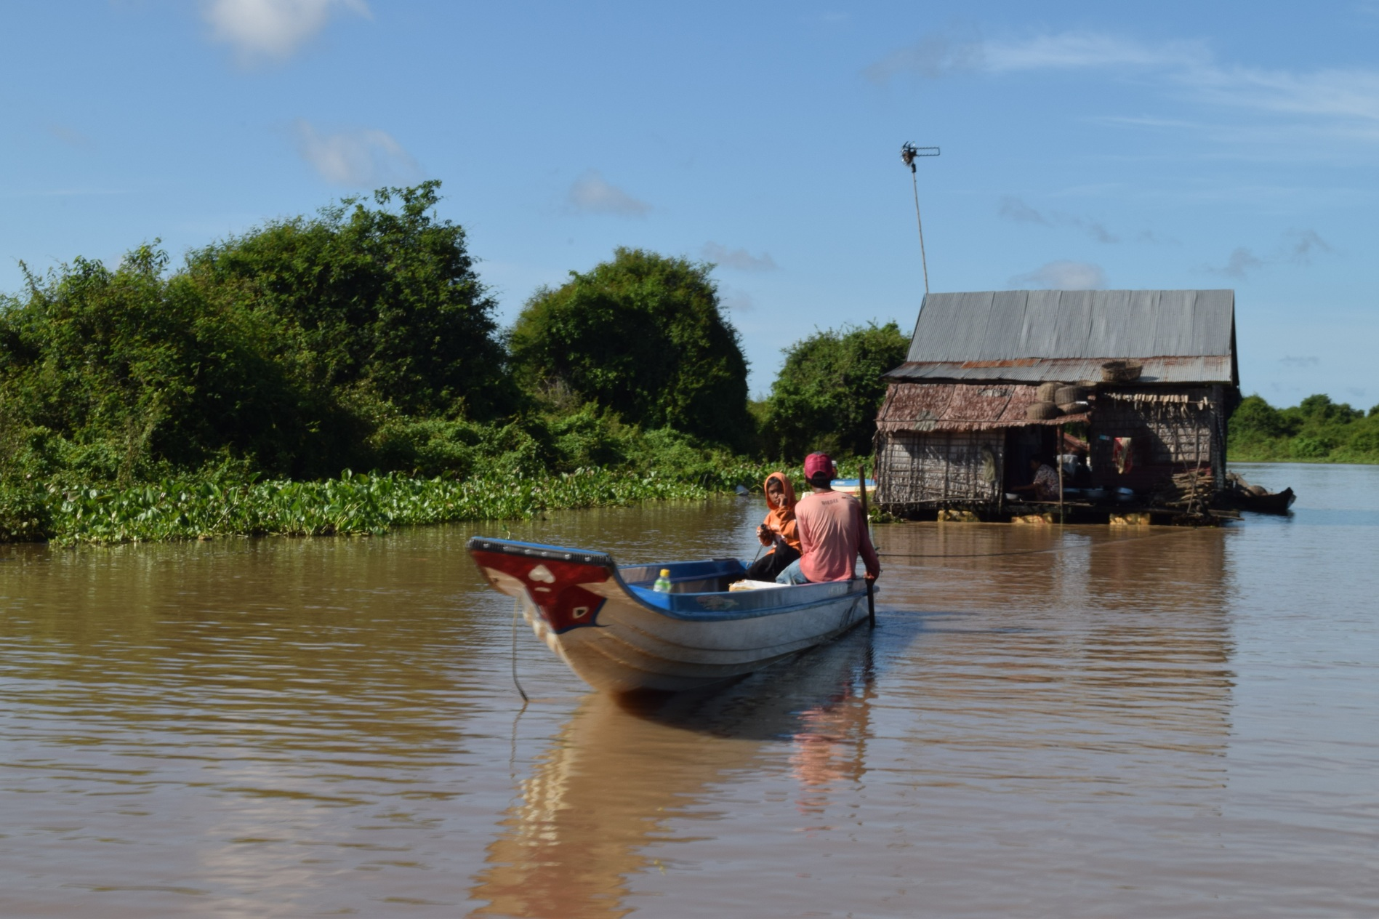
Any Questions?

